Slide 1
Relational Database Design by ER-to- Relational Mapping

Slide 2
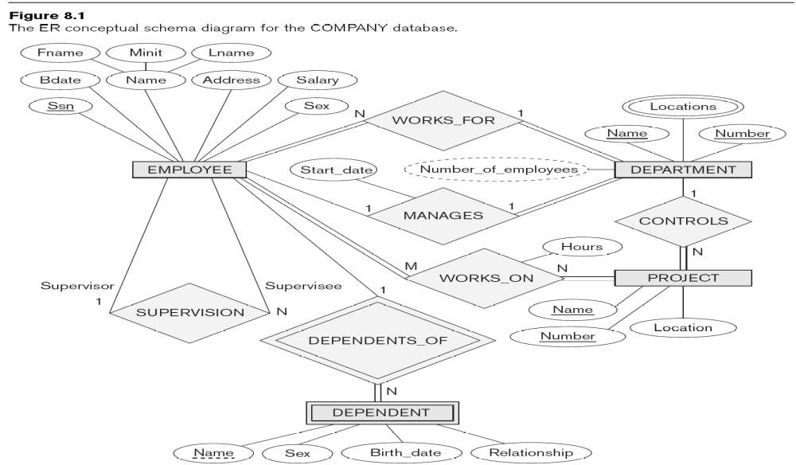
ER-to-Relational Mapping Algorithm
Seven-step algorithm to convert the basic ER model constructs into relations

Slide 3
Step-1 Mapping of regular Entity Types
For each strong entity type E in the ER schema, create a relation R that includes all the simple attributes of E. Include only the simple component attributes of a composite attribute.
Choose one of the key attribute of E as primary key of R.
Called entity relations because each tuple represents an entity instance

Slide 4
Step 2: Mapping of Weak Entity Types
For each weak entity type, create a relation R and include all simple attributes of the entity type as attributes of R.
Include primary key attribute of owner as foreign key attributes of R
The primary key of R is the combination of primary key of owner and the partial key of the weak entity type.
It is common to choose the CASCADE option for referential triggered action on the foreign key in the relation corresponding to the weak entity type.

Slide 5
Step 3: Mapping of Binary 1:1 Relationship Types
For each 1:1 relationship type R in ER schema, identify the relations S and T that correspond to entity types participating in R.
There are three possible approaches.
Foreign key approach
Merged relationship approach
Cross-reference or relationship relation approach

Slide 6
1. Foreign Key approach
Choose on relation S, say and include foreign key in S the primary key of T. It is batter to choose an entity type with total participation in R in the role of S.
Include all simple attributes of 1:1 relationship type as attribute of S.

Slide 7
2. Merged relation option
An alternative mapping of 1:1 relationship type is possible by merging the two entity types and relationship into a single relation.
This may be appropriate when both participations are total.

Slide 8
3. Cross-reference
Create a third relation R for the purpose of cross-referencing the primary keys of two relations S and T representing the entity types.

Slide 9
Step 4: Mapping of Binary 1:N Relationship Types
For each regular binary 1:N relationship type R, identify the relation S that represents the participating entity type at the N-side of the relationship type.
Include as foreign key in S the primary key of relation T that represents the other entity type participating R.
This is done because each entity instance on the N-side is related to at most one entity instance on the 1-side of the relationship type.
Include any simple attribute of R as attribute of S.

Slide 10
Step 5: Mapping of Binary M:N Relationship Types
For each binary M:N relationship type R, create a new relation S to represent R.
Include as foreign key attributes in S the primary keys of the relation that represent the participating entity types; their combination will form the primary key of S.
Also include any simple attributes of M:N relationship type as attributes of S.

Slide 11
Step 6: Mapping of Multivalued Attributes
For each multivalued attribute A, create a relation R. R will include an attribute corresponding to A, plus the primary attribute K as a foreign key in R of the the relation that represents the entity type that has A as an attribute.
The primary key of R is the combination of A and K.

Slide 12
Step 7: Mapping of N-ary Relationship Types
For each n-ary relationship type R, create a new relation S to represent R. Include as foreign key attributes in S the primary keys of the relations that represent the participating entity types.
Also include any simple attributes of n-ary relationship type as attributes of S.

Slide 13
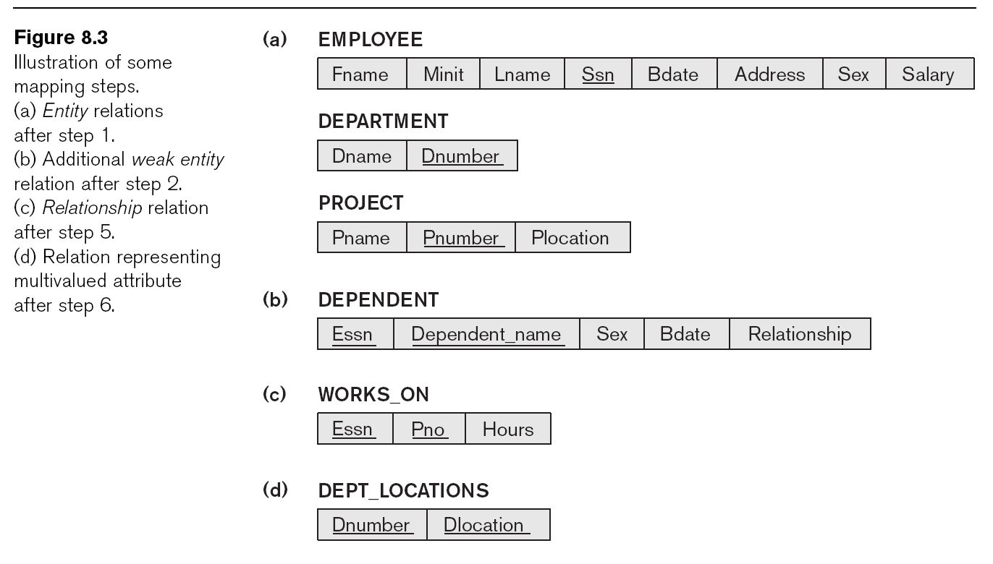

Slide 14
Mapping of Specialization or Generalization
Step – 8: Covert each specialization with m subclasses {S₁, S₂, …...., S_{m}) and superclass C, where the attributes of C are {k, a₁, a₂,,...a_{n})
K is the primary key.
Option 1: Multiple relations – superclass and subclasses-- Create a relation L for C with attributes {k, a₁, a₂,...... a_{n}) and PK(L) = k. Create a relation L_{i}, for each subclass S_{i} with the attributes {k} U {attributes of S_{i}} and PK(L_{i}) = k. This option works for any specialization (total or partial, disjoint, over-lapping)

Slide 15
Mapping of Specialization or Generalization
Option -2: Multiple relations- subclass relations only-- Create a relation L_{i}, for each subclass S_{i} with the attributes {attributes of S_{i}} U {k, a₁, a₂,...... a_{n}}and PK(L_{i}) = k. This option only works for a specialization whose subclasses are total (every entity in the superclass must belong to (at least) one of the subclass)

Slide 16
Mapping of Specialization or Generalization
Option-3: Single relation with one type attribute – Create a single relation L with attributes {k, a₁, a₂,,...a_{n} } U {attributes of S1} …...U{attributes of Sm} U {t} and PK(k). The attribute t is called a type (or discriminating) attribute that indicates the subclass to which the tuple belongs. This option works only for a specialization whose subclasses are disjoint

